Slide 1
Network Artificial Intelligence (NAI)
draft-zheng-opsawg-network-ai-usecases
Yi Zheng, China Unicom
Zhenbin Li, Jinhui Zhang, Xu Shiping, Dhruv Dhody, Huawei

Slide 2
Introduction
Explore how Artificial Intelligence (AI) & Machine Learning (ML) can be applied to the network use-cases.
As networks get more and more dynamic & complex, there are new challenges to network management and optimization!
Can NAI help?
What is a role of a central controller / SDN?
Use Intelligence to drive the controller.
Implement the recommendations & decisions made by the AI.
This use-case document discusses how the Network Artificial Intelligence (NAI) is able to be applied in the various possible use-cases.
draft-li-rtgwg-network-ai-arch is a companion document.

Slide 3
Key Functions
Telemetry and Historical Data
Machine Learning
Closed Loop Control
Via SDN
Analytics
Detection
Prescription
Prediction
Build a Network Telemetry Analytics (NTA) engine, usually collocated with a central controller.
E2E deployment may involve multiple NTA engines coordinating with each other similar to the controllers.

Slide 4
Enhance Path Computation and Traffic Engineering
NTA
Historical Record &
Telemetry
PCE has access to TEDB + LSP-DB
Adding history records of the changes in the LSP-DB and TEDB for future analytics
Adding Network Telemetry as well as real-time analytics of traffic monitoring, statistics etc.
PCE reroute/re-optimize using the historical trend and predications from NAI.
PCE could handle the changes in bandwidth utilization and other performance monitoring data for predicted traffic congestion avoidance.
Build intelligent context -
What are the LSPs used for?
PCE
PCEP, BGP-LS etc.
Network Telemetry

Slide 5
Route Monitoring and Analytics
BMP can be used to monitor the BGP peer.
The controller can monitor the BGP status and routing information of the routers using BMP.
Historical records of changes can be maintained in the NTA for analytics.
Performance Telemetry information about inter-AS links.
Possible use-cases
BGP Route Leaks
BGP Hijacks
Traffic Analytics and intelligent Egress Traffic Engineering
Intelligent detection via anomaly detection!
Controller
NTA
ISP1
ISP2

Slide 6
Multilayer Fault Detection in NFV
NTA
Telemetry data from all layers -
CPU performance, memory usage, interface bandwidth and other KPI indicators can be monitored.
At the same time resource occupancy and the life cycle of NVF software process can also be monitored.
Historical records – correlate and categorize.
Through the NAI, the relevant statistical data in multiple levels can be analyzed and the models can be setup to locate the root cause for the possible fault in the multi-layer environment.
Intelligent Health Diagnostic.
VNF
VNF
VNF
MANO
Compute
Network
Storage
Virtualization Layer
Compute
Network
Storage

Slide 7
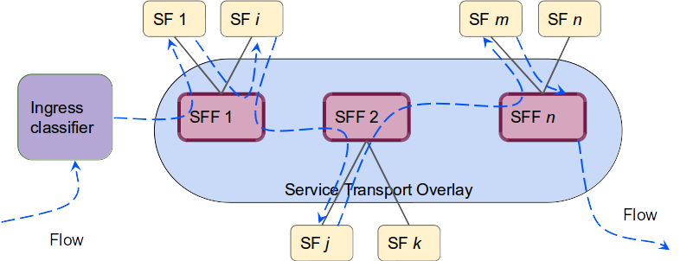
Smart SFC
Network Telemetry - delay, jitter, packet loss from the network.
Service telemetry - CPU/memory usage utilizations from the SFs.
Via sFlow/gRPC protocol and stored as historical records.
The analytics component in NTA can build models to predict the impact on various Service Function Paths due to network events, traffic and state of the SFPs and instruct the SFC controller to take necessary actions.
The SFC controller can calculate new paths/reroute the SFC path to avoid congested Ports/SFFs or overloaded SFs.
SFC
Controller
NTA
Telemetry

Slide 8
Architectural Considerations
Placement of NTA
Collocated with Controller
Integrated with controller
Handling of multi-domain controllers
Analytics closer to the source is better!
Hierarchy (like ACTN…)
Building Blocks
Telemetry Collector (Data Collector)
Data Movement
Analytics – real time or batch
ML Models
Visualization
Closed Loop Interactions

Slide 9
Next Steps
Are these the right set of use-case to explore AI/ML in the networks?
Do you have other use-cases?
Is it useful to document them and discuss?
Please suggest and collaborate!
What are the architectural considerations?
Are there any protocol considerations?
Are there are operations considerations?
Build prototypes, reuse various possible open-source.
Hopefully in a future Hackathon!

Slide 10
Thank You!

